Slide 1



CIT 280 | THE TRAINING MODULE
Build A Website With Bootstrap, SCSS, And Firebase
Authors Connor | Noah | Scott | Cati | Richie

Slide 2
Introduction
Overview
The focus of this activity is for individuals to learn the basics of various development toolkits and then build and deploy a simple, single-page site using said tools.
This Module’s Scope
Using Bootstrap to enhance mobile/responsive web development.
Incorporating Sass to override Bootstrap styles.
Deploying your website with Firebase.
Notes:
sdfsdfsd

Slide 3
Learning Outcomes
Objectives
Students will demonstrate an understanding of Sass.
Students will demonstrate an understanding of Bootstrap.
Students will setup a local development environment.
Students will create a SPA using HTML, Sass, and Bootstrap.
Students will deploy a SPA using Google Firebase.

Slide 4
Presentation Overview
Here is what to expect in this presentation:
An introduction to Bootstrap, Sass, and Firebase.
A live demonstration on how to use each technology in website development.
A final project/assessment to test your knowledge.

Slide 5
Bootstrap
Bootstrap is an open source toolkit for front-end development. It is used to create responsive & mobile websites.
There are several ways to start using Bootstrap:
Download the compiled CSS & JS files.
Download the source files.
Use the CDN option.
Install through a Package Manager.
<div class="jumbotron">Hello</div>

Slide 6
SASS (SCSS)
Sass enhances CSS programming. It provides variables, operators, imports, and more to assist developers. Sass must be compiled to CSS.
$color: #eee; $margin: 1024/2; body{ color: $color; margin: $margin; }

Slide 7

Google Firebase
Firebase is a platform for web application development on the cloud.
Several of its features include:
A NoSQL Database
Web Hosting
User Authentication
File Storage

Slide 8
Let’s Review The Tools
Twitter Bootstrap
Bootstrap is a front-end framework for building responsive and mobile websites.
SASS
SASS (Syntactically Awesome Stylesheets) is a CSS Preprocessor that enhances traditional CSS programming.
Google Firebase
Google Firebase is a platform for web application development on the cloud.

Slide 9
Build
Responsive web pages
Style
And customize your website
Deploy
To a live environment

Slide 10
Our Website
Website Link:
https://cit280-training-module.firebaseapp.com
We built a website to demonstrate how to use Bootstrap, Sass, and Firebase in web development.
This website can also help in the lab...

Slide 11
Lab Overview
Setup the development environment.
Build a simple website using Bootstrap.
Add custom styles with SCSS.
Deploy the website with Firebase.
Complete and submit the assessment form.
Listed to the right are five basic steps to complete the Training Module Lab.
For detailed instructions, click here

Slide 12
Get Started
Click Here to Begin

Slide 13
Thank You!
Please leave your feedback about our Training Module here. We hope you enjoyed!

Slide 15
Instructions for use
EDIT IN GOOGLE SLIDES
Click on the button under the presentation preview that says "Use as Google Slides Theme".
You will get a copy of this document on your Google Drive and will be able to edit, add or delete slides.
You have to be signed in to your Google account.
EDIT IN POWERPOINT®
Click on the button under the presentation preview that says "Download as PowerPoint template". You will get a .pptx file that you can edit in PowerPoint.
Remember to download and install the fonts used in this presentation (you’ll find the links to the font files needed in the Presentation design slide)
More info on how to use this template at www.slidescarnival.com/help-use-presentation-template
This template is free to use under Creative Commons Attribution license. You can keep the Credits slide or mention SlidesCarnival and other resources used in a slide footer.

Slide 16
This template is for a SlideDoc
A slidedoc is a visual document, developed in presentation software, that is intended to be read and referenced instead of projected.
Slidedocs help you spread your smart thinking by combining visual communications with short chunks of written copy. Their scannable nature makes them great pre-read, reference, and leave-behind materials. Their modularity makes it easy for people to incorporate your ideas into their own communications. And these features together make slidedocs the perfect companion to both written documents and presentations.
Text from duarte.com/slidedocs

Slide 17
Table of contents
Section one
Section two
Even another section
And there can be subsections too.
Subsection
Section four
This is a template optimized for SlideDocs. As it is a long document you should inform the reader about its contents.

Slide 18

Hello!
Nice to meet you
Use the first slides to present yourself or your company. Remember that you may not be presenting this document directly.
Contact us at:
www.ourwebsite.com
hello@mail.me
@companyname

Slide 19
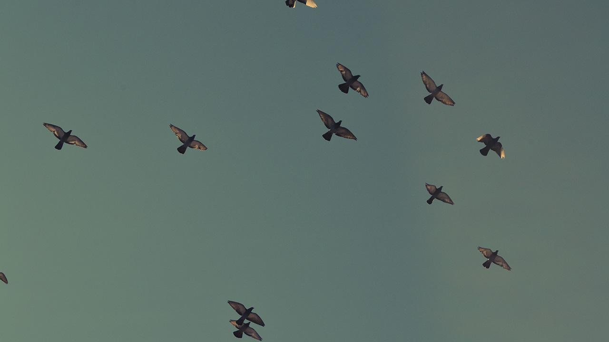
1.
TRANSITION HEADLINE
Let’s start with the first set of slides

Slide 20
Quotations are commonly printed as a means of inspiration and to invoke philosophical thoughts from the reader.

Slide 21
This is a slide title
SlideDocs are for distribution; they’re not optimized for presenting. Slides have too much text and font size is too small for an audience to read it projected in a screen.
These documents are useful for:
Distribute before a meeting when the topic is highly complex or technical
To fully explain your idea before booking a meeting with someone
As a reference and follow-up material
Distribute
Explain
Follow-up

Slide 22
You can also split your content
Try to communicate ideas visually using graphs, icons, illustrations, photos… any resource that helps you convey your message at a glance.
White
Is the color of milk and fresh snow, the color produced by the combination of all the colors of the visible spectrum.
Black
Is the color of coal, ebony, and of outer space. It is the darkest color, the result of the absence of or complete absorption of light.

Slide 23
In two or three columns
Yellow
Is the color of gold, butter and ripe lemons. In the spectrum of visible light, yellow is found between green and orange.
According to surveys in Europe, Canada, and the United States, yellow is the color people most often associate with amusement, gentleness, and spontaneity, but also with duplicity, envy, jealousy, avarice, and, in the U.S., with cowardice.
It plays an important role in Asian culture, particularly in China, where it is seen as the color of happiness, glory, wisdom, harmony, and culture.
Blue
Is the colour of the clear sky and the deep sea. It is located between violet and green on the optical spectrum.
Surveys in the US and Europe show that blue is the colour most commonly associated with harmony, faithfulness, confidence, distance, infinity, the imagination, cold, and sometimes with sadness.
In US and European public opinion polls it is the most popular colour, chosen by almost half of both men and women as their favourite colour.
Red
Is the color of blood, and because of this it has historically been associated with sacrifice, danger and courage.
Modern surveys in the United States and Europe show red is also the color most commonly associated with heat, activity, passion, sexuality, anger, love and joy. Red is also a color widely used for getting attention, such as stop signs or royal dresses.
In China, India and many other Asian countries it is the color of symbolizing happiness and good fortune.

Slide 24
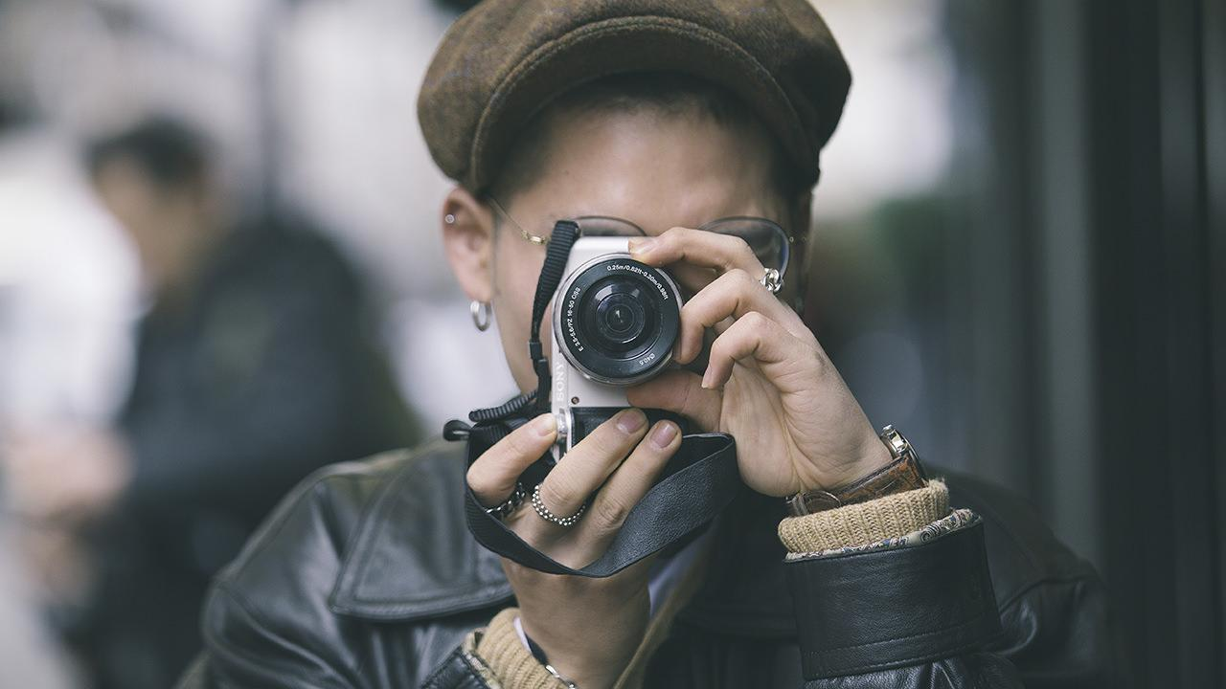
A picture is worth a thousand words
A complex idea can be conveyed with just a single still image, namely making it possible to absorb large amounts of data quickly.

Slide 25
Use charts to explain your ideas
Item 1
Item 2
THE
CONCEPT
Item 3
Item 4

Slide 26
And tables to compare data
As a communication tool, a table allows a form of generalization of information from an unlimited number of different social or scientific contexts. It provides a familiar way to convey information that might otherwise not be obvious or readily understood.
 | A | B | C
Yellow | 10 | 20 | 7
Blue | 30 | 15 | 10
Orange | 5 | 24 | 16

Slide 27
Maps
our office
The word "map" comes from the medieval Latin Mappa mundi, wherein mappa meant napkin or cloth and mundi the world.

Slide 28
And even more numbers
89,526,124$
That’s a lot of money
185,244 users
And a lot of users
100%
Total success!

Slide 29
The Process
Deploy
Style
Build

Slide 30
Our process is easy
last
second
first

Slide 31
Let’s Review The Tools
Twitter Bootstrap
Is the color of gold, butter and ripe lemons. In the spectrum of visible light, yellow is found between green and orange.
SCSS
Is the colour of the clear sky and the deep sea. It is located between violet and green on the optical spectrum.
Google Firebase
Is the color of blood, and because of this it has historically been associated with sacrifice, danger and courage.
Yellow
Is the color of gold, butter and ripe lemons. In the spectrum of visible light, yellow is found between green and orange.
Blue
Is the colour of the clear sky and the deep sea. It is located between violet and green on the optical spectrum.
Red
Is the color of blood, and because of this it has historically been associated with sacrifice, danger and courage.

Slide 32
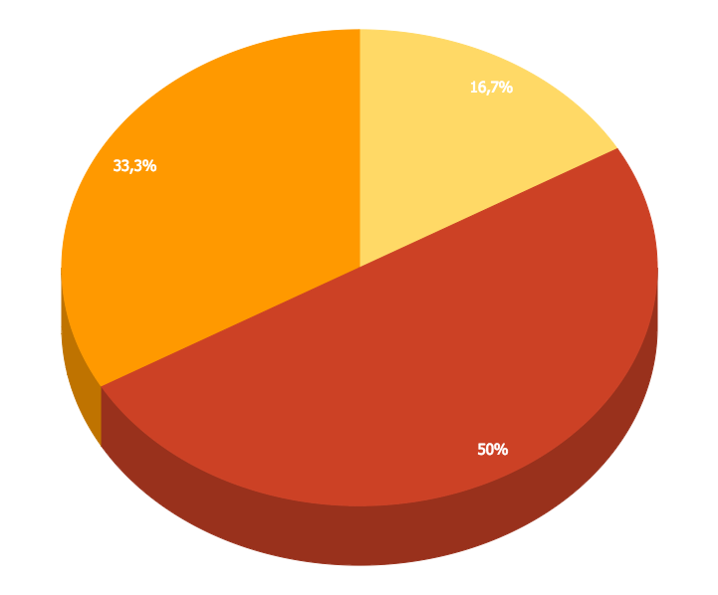
You can insert graphs from Google Sheets

Slide 33
Android Project
Place your screenshot here
Show and explain your web, app or software projects using these gadget templates.

Slide 34
iPhone Project
Place your screenshot here
Show and explain your web, app or software projects using these gadget templates.

Slide 35
Tablet
Project
Place your screenshot here
Show and explain your web, app or software projects using these gadget templates.

Slide 36
Desktop Project
Place your screenshot here
Show and explain your web, app or software projects using these gadget templates.

Slide 37
Thank you very much for your time
If you have any questions about this document please don’t hesitate to contact us at:
www.ourwebsite.com
hello@mail.me
@companyname

Slide 38
Credits
Special thanks to all the people who made and released these awesome resources for free.
Presentation template by SlidesCarnival
Photographs by Unsplash
Learn more about slidedocs at duarte.com/slidedocs

Slide 39
Presentation design
This presentation uses the following typographies and colors:
Titles: Nunito sans
Body copy: Nunito sans
Italic copy: Georgia (system font)
You can download the font on this page:
https://fontlibrary.org/en/font/nunito-sans
Orange #f67031
Yellow #ffa400
Fucsia #ed0036
You don’t need to keep this slide in your presentation. It’s only here to serve you as a design guide if you need to create new slides or download the fonts to edit the presentation in PowerPoint®

Slide 40
SlidesCarnival icons are editable shapes.
This means that you can:
Resize them without losing quality.
Change line color, width and style.
Isn’t that nice? :)
Examples:

Slide 41
😉
Now you can use any emoji as an icon!
And of course it resizes without losing quality and you can change the color.
How? Follow Google instructions https://twitter.com/googledocs/status/730087240156643328
✋👆👉👍👤👦👧👨👩👪💃🏃💑❤😂😉😋😒😭👶😸🐟🍒🍔💣📌📖🔨🎃🎈🎨🏈🏰🌏🔌🔑 and many more...

